Slide 1

BASIC BLACKBOARD
AUSTIN COMMUNITY COLLEGE

Slide 2
NOTE ADDITIONAL TRAINING AVAILABLE:
Workshops are available at: https://eapps.austincc.edu/workshops/www/login.php
Log in with your ACCeID and search for “Blackboard”
You will find these workshops
Blackboard 1: Building a Course Site – 2 hrs
Blackboard 2: Assignments and Assessments – 2 hrs
Blackboard 3: Grade Center – 2 hrs
Blackboard 4: Interactive Tools – 2hrs
Blackboard Collaborat Ultra Training – 1.5 hrs
Total of 9.5 hrs online and self-paced

Slide 3
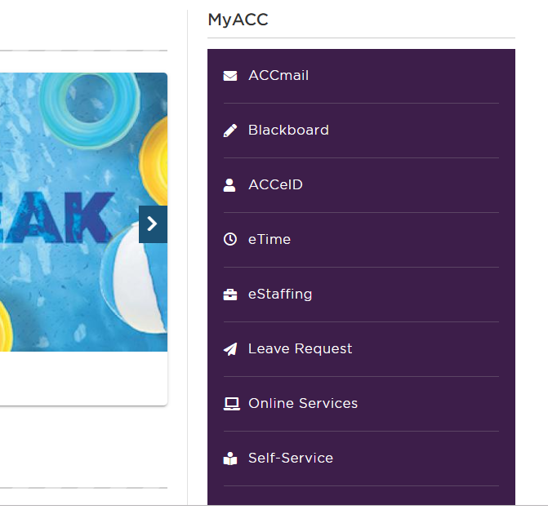
Getting to blackboard

Slide 4
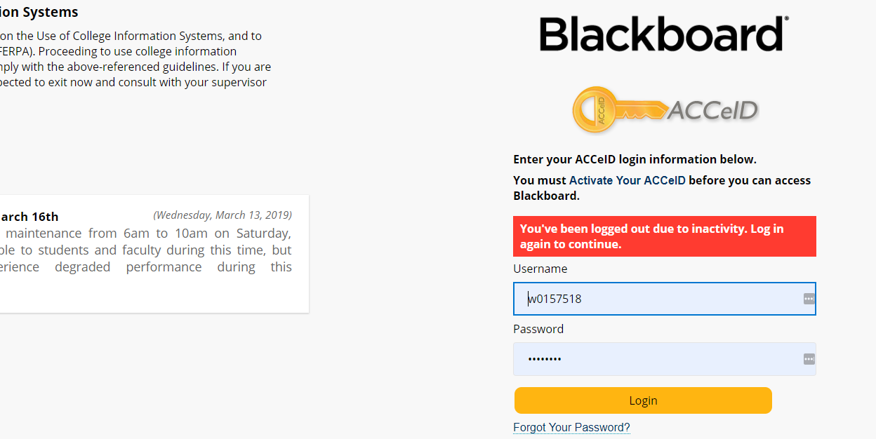
Sign in using your acEid

Slide 5
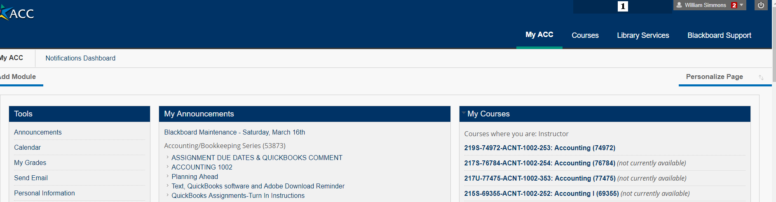
Your course listings

Slide 6
Your current courses

Slide 7
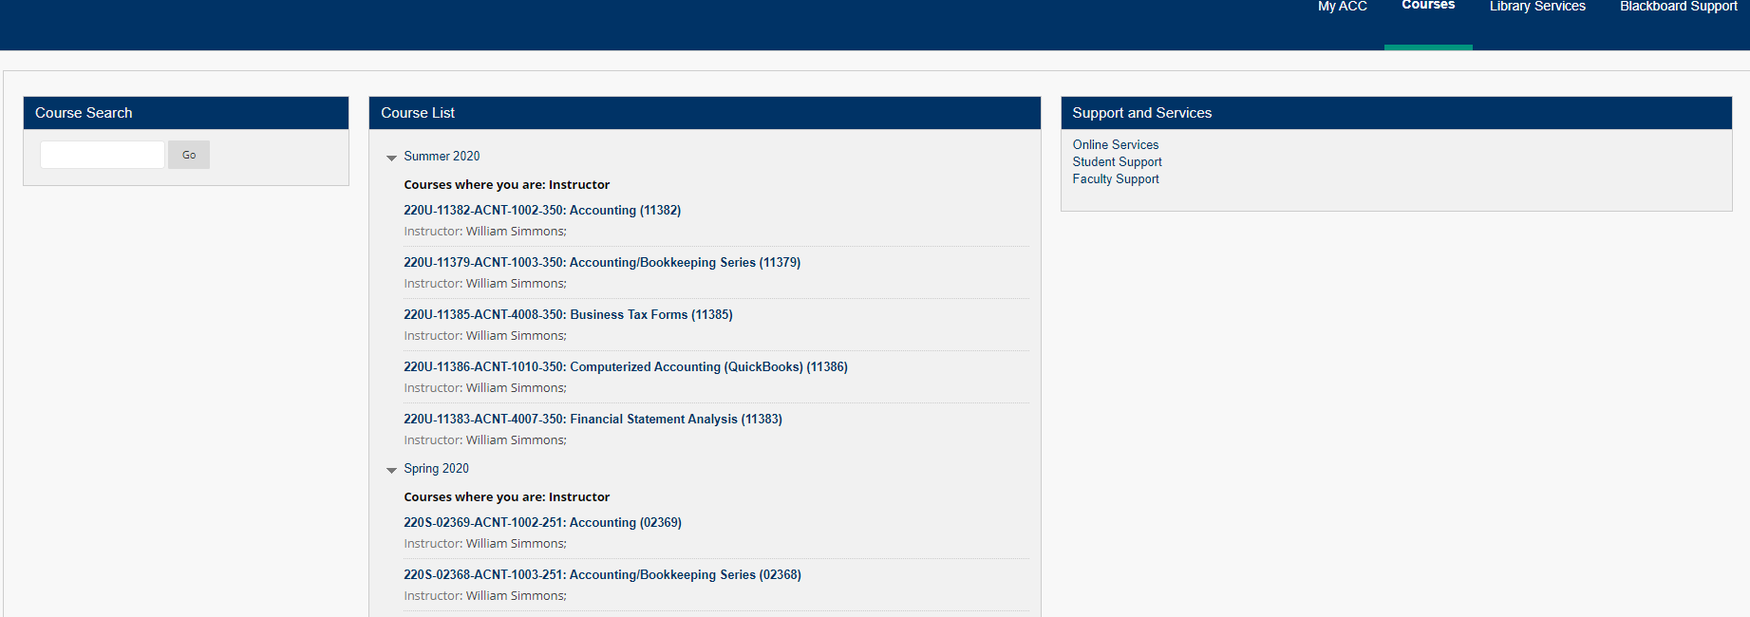
Select the course to work on

Slide 8
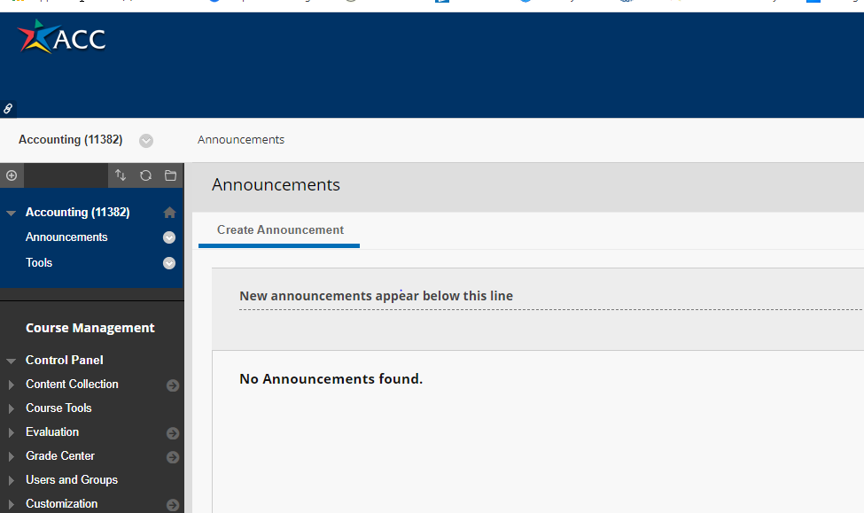
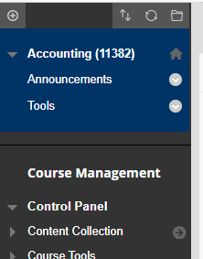
Menu bar FOR INTERACTIVE TOOLS opens

Slide 9
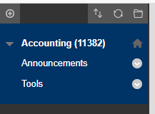
Adding a menu item

Slide 10
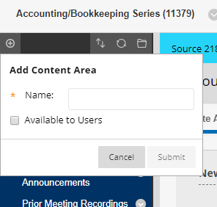
Creating a new content area

Slide 11
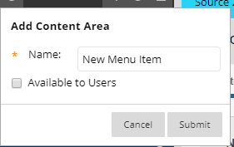
Creating a new menu item - cont
A list of types of menu items opens. We select “Content Area”

Slide 12
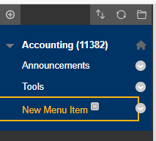
New Menu Item is now listed

Slide 13
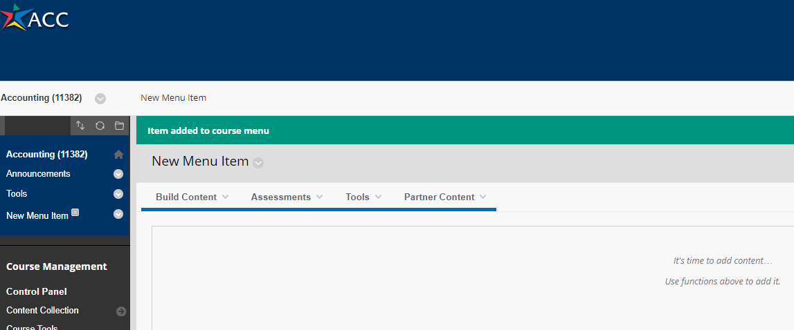
By clicking on the new menu item – its content area opens

Slide 14
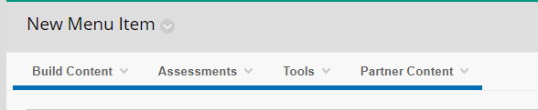
We select the “Build Content” option

Slide 15
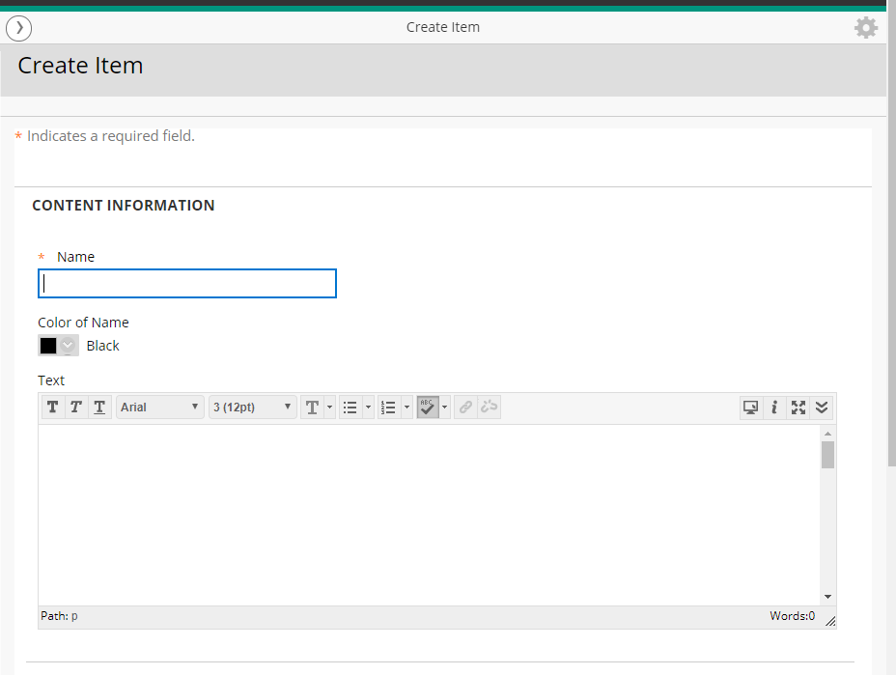
Select “Item” from the menu
We then enter the name of the item: “Handouts” and create instructions in the text area for our students telling them these handouts are for the class

Slide 16
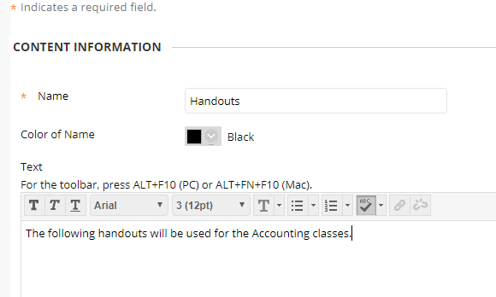
Your new menu item now looks like this.
Below the “text” area is the “attachment area”

Slide 17
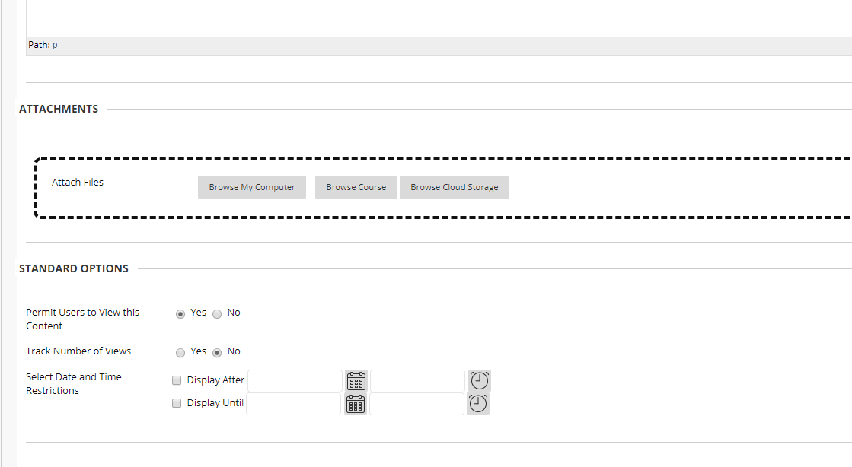
Attaching handouts/files
File location on your computer
Additional options to consider

Slide 18
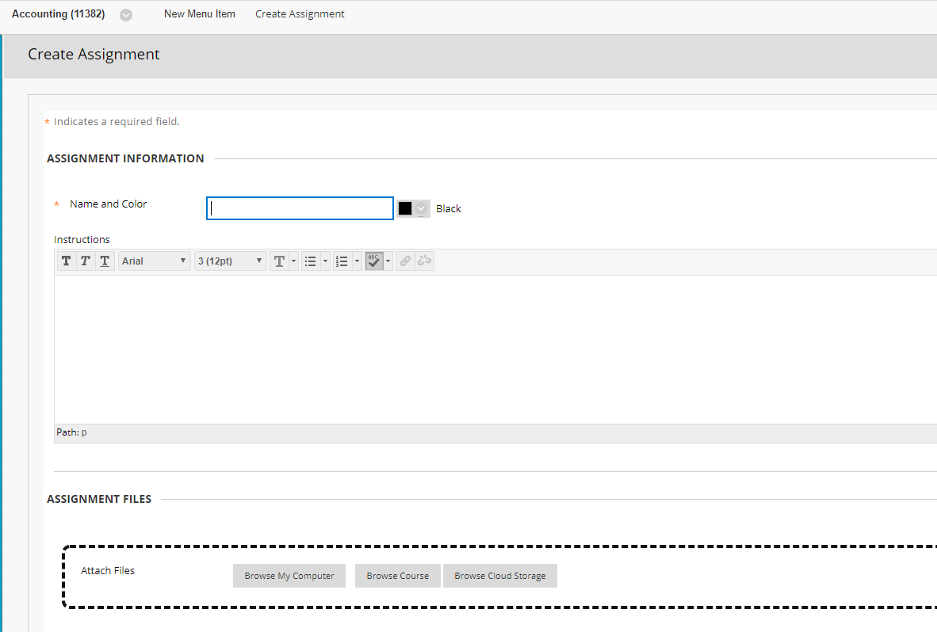
Creating Assignment Information

Slide 19
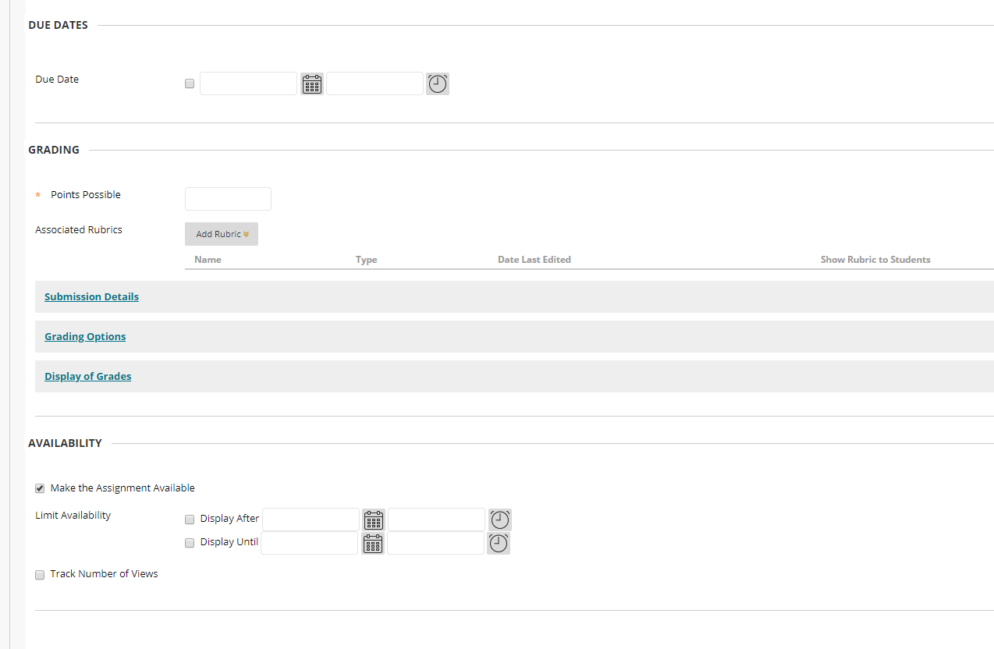
Enter due date and availability dates

Slide 20
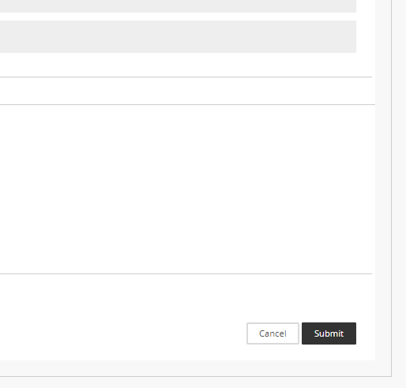
You must submit to save the content
Box is located at the right bottom of the screen

Slide 21

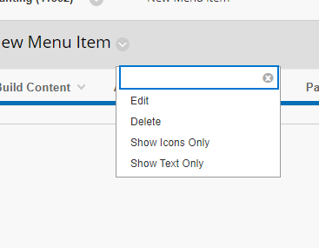
Editing content

Slide 22
conclusion
To learn more about how Blackboard works – explore
I recommend you also attend the online training available at: https://eapps.austincc.edu/workshops/www/login.php
You may also consider attending the additional sessions for the Basic Blackboard training now being offered
In order to present your classes online, you will need to attend the Basic Collaboration training being offered

